Slide 1
Expurgo Re-Tyre
Draft for
NASA Space App Challenge
Sai Ghule
Note: This is a selected draft excerpt shared for reference. The complete presentation is available upon request. Citations, references, and fully functional working code can also be provided upon request.

Slide 2
The Ever Increasing Pollution Problem

Slide 3
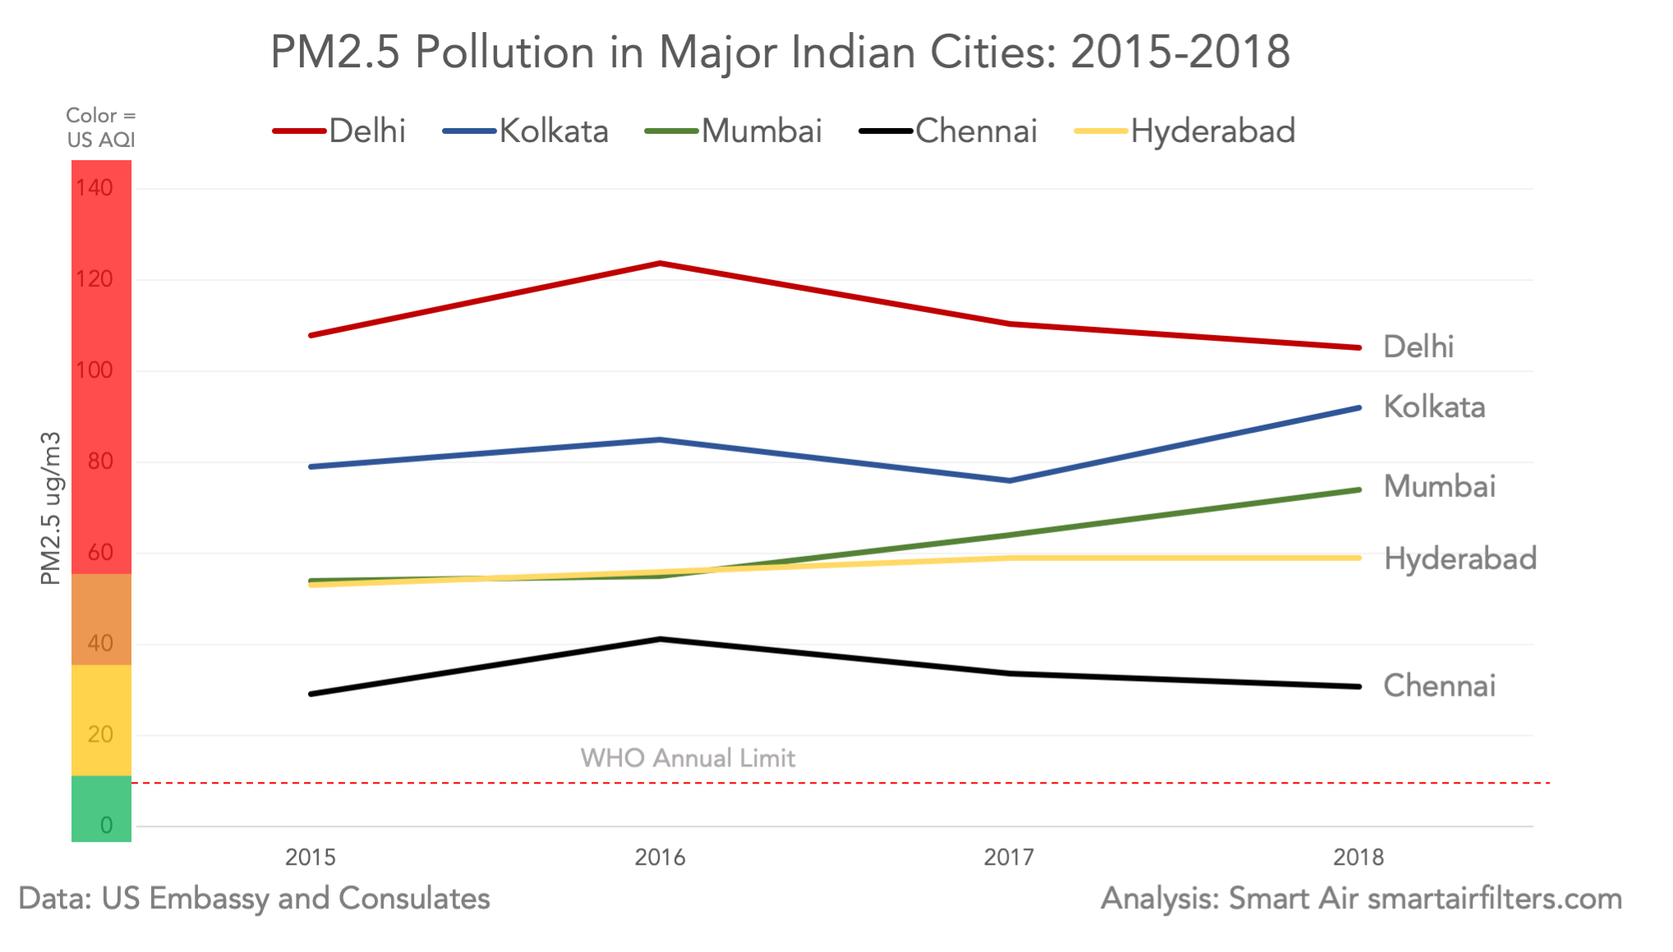

Slide 4
76% Indians live in places that do not meet national air quality standards.
New research indicates that air pollution impacts birth weight, child growth, obesity, and bladder cancer.
Children and elderly are disproportionately affected.

Slide 5
Our Solution

Slide 6
A strap-on, multi-layered, emission absorbing pad which can be fitted on the tyres of a vehicle
The function of this pad is to absorb harmful gases like CO2, CO, SO2 from the environment around it.
It has three layers, each with a unique function as can be seen in the figure.

Slide 7
Advantages of Tyre-pad
Statistically, the hydrated sodium carbonate can achieve a very high CO2 absorption capacity of 282 mg/g within 60 min proving the viability of the product.
Easy to install.
Cost effective and active pollution control product.
Recyclable.

Slide 8
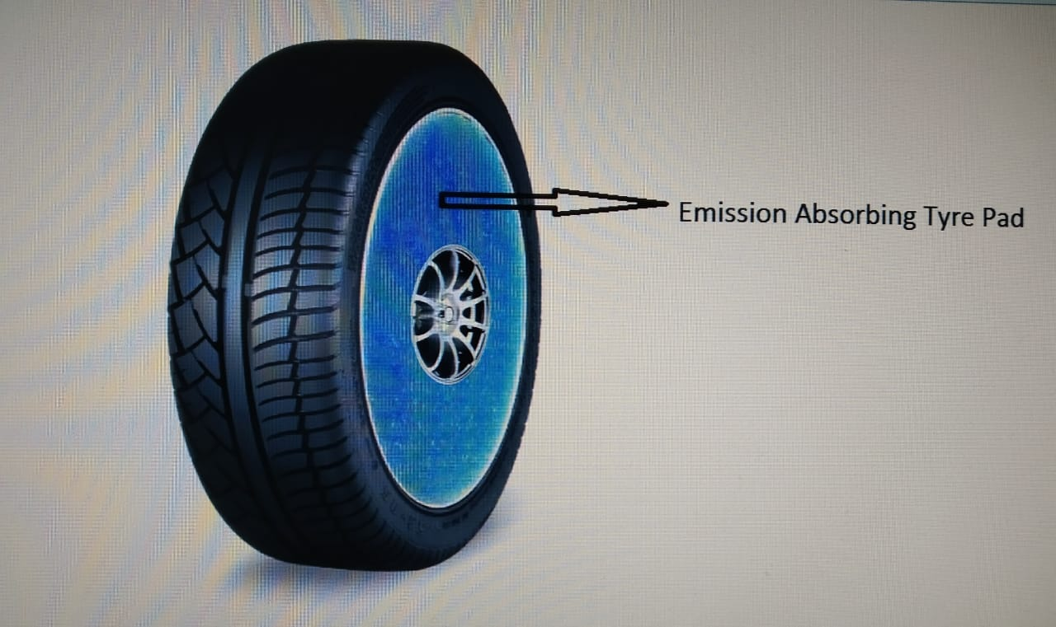

Slide 9
Features
Real time tracking through sensors.
Processing the data on the cloud using a machine learning model to come up with user specific analysis.
Analysis visualized for the users through the use of graphs and various diagrams.
Gamification methods to engage and educate users

Slide 10
Gamification

Slide 11
Research shows that people from all age groups from a child to an old person, all of them learn and understand quickly through visualizations.
Our app shows Data Visualizations of the gases absorbed by their tyre pad and hence each person can know how they have contributed in reducing pollution.
Also here the gamification idea is to give people badges which they can share on their social media and show to the world the how many lives they saved.
Even if not for the reason of reducing pollution there is a high probability people will use the app for flaunting on social media.

Slide 12
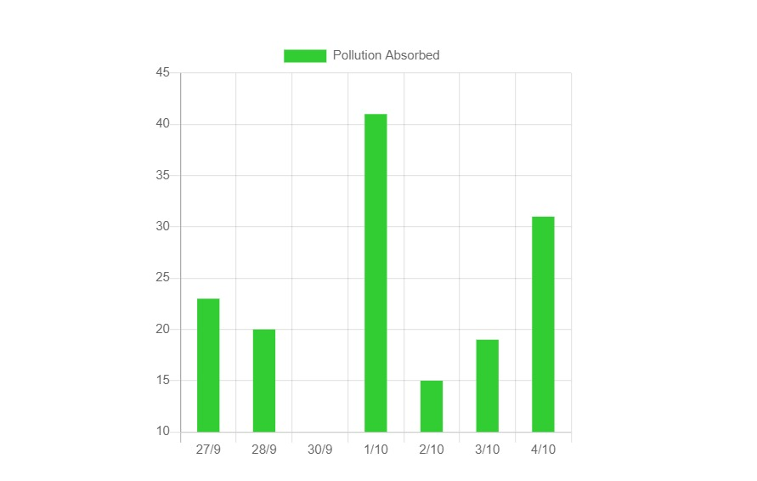
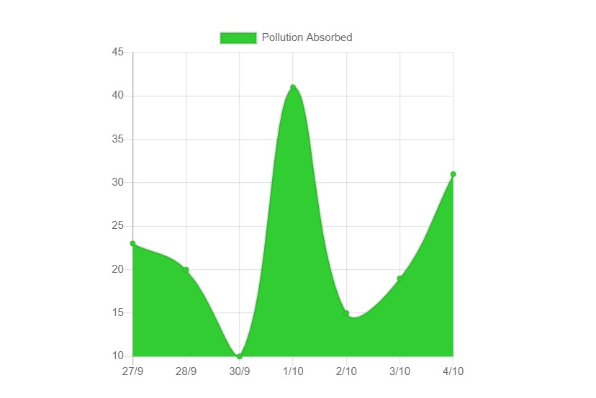
Data visualization in the App

Slide 13
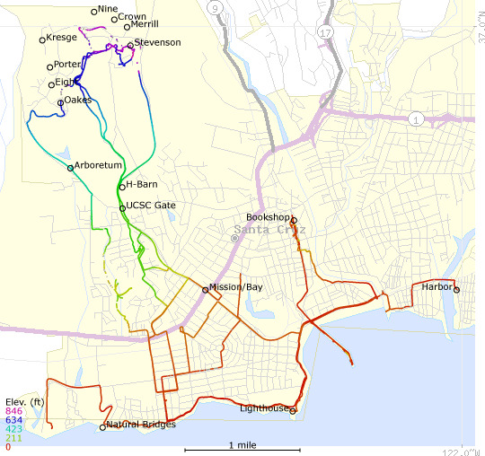
Route Tracking Feature

Slide 14
Flow Diagram

Slide 15
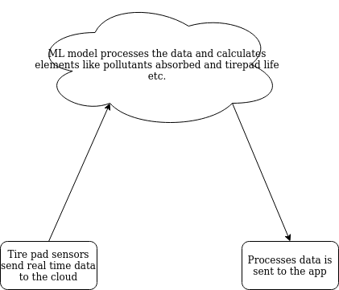

Slide 16
Projected Absorption

Slide 17
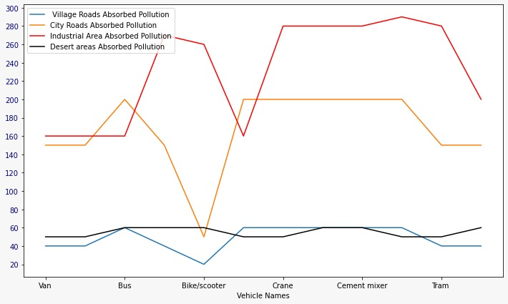
Projected Absorption

Slide 18
Tech Stack
React Native for front-end.
Google cloud services.
Python + SQL for machine learning model
NASA dataset: Air pollution

Slide 19
A User-friendly website with an option to download the app

Slide 20


Slide 21
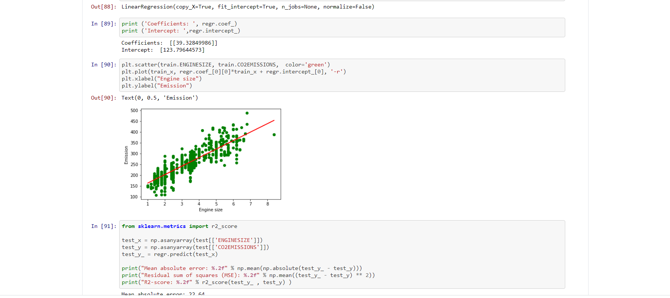
A snapshot of the ML code

Slide 22
Conclusion

Slide 23
Statistics shows only 19% Indians are aware and understand the severity of air pollution.
Hence the proposed solution of this absorbent tyre pad offers an easy and reliable solution to curb the increasing pollution.
The unique features of this app like route tracking, data visualization, life expectancy updates ensure that the people will be engaged and educated in the right direction.

Slide 24
Thank You!

